Slide 1


Slide 2






About Me
Software engineer, FireSwitch Technologies
Contributor, CHAOSS
@AYK_dev
Adeyinka J. Oresanya
adeyinkaoresanya@gmail.com
medium.com/developers-compass

Slide 3
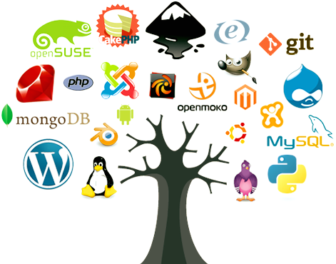
What is Open source software (OSS)?
Open Source is a collaborative software development model where the source code is freely accessible and modifiable.
Freely distributed source code
Easily accessed
Can be modified

Slide 4
Ways to contribute to open source?
Code contribution
Non-code contribution:
Technical writing (documentation)
Community management
Research
Project management
Design
Marketing and partnerships

Slide 5
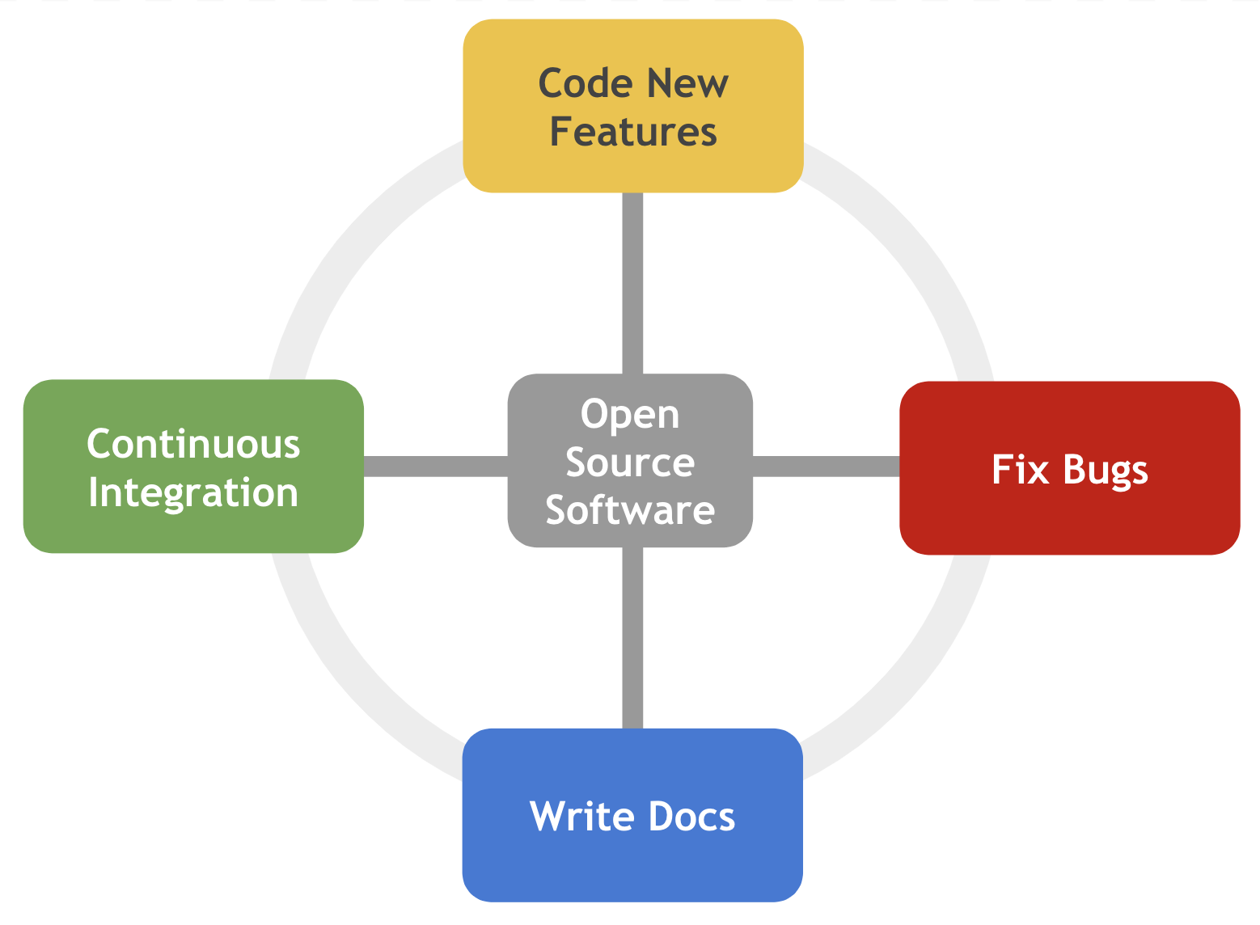
What is open source documentation?
The art of creating communicable materials used to describe, explain, or instruct users or contributors of an open-source software regarding its parts, assembly, installation, maintenance, and use.
Documentation plays a vital role in explaining how to use the software, contribute to its development, and understand its technical aspects.
It includes user guides, API references, tutorials, code comments, and more.

Slide 6
Importance of documentation in open source?
Improves software usability: Clear instructions lead to better adoption and fewer frustrated users.
Fosters community engagement: Documentation empowers users to contribute, report issues, and suggest improvements.
Attracts new developers: Well-documented code is more approachable and inviting to potential contributors.
Ensures project sustainability: Comprehensive documentation makes future maintenance and development easier.

Slide 7
When is Open Source Documentation Crucial?
When onboarding new users and contributors.
When introducing new features or functionalities.
When resolving bugs and technical issues.
When seeking community feedback and contributions.
Whenever clarity and understanding are critical.

Slide 8

Where can Open Source Documentation be found?
Project websites and wikis: e.g. https://firebase.google.com/docs, https://github.com/chaoss/chaoss-slack-bot/wiki/
Collaboration platforms like GitHub, GitLab: https://pandas.pydata.org/docs/ (https://github.com/pandas-dev/pandas/blob/main/doc/source/user_guide/dsintro.rst), https://github.com/adeyinkaoresanya/badging-bot/blob/adeyinka-tutorial-contributions/TUTORIAL.md
Community forums and mailing lists
Search engines (https://osm.hpi.de/bs/2019/material/The_Linux_Users_Guide.pdf )

Slide 9
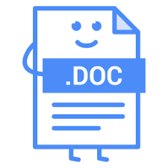
Tools and Platforms used for collaboration
Version control:
GitHub
GitLab
BitBucket
Documentation tools:
ReadMe
GitBook
Google Doc
Doxygen
Confluence
Read the Docs
Communication channel:
Slack
Discord

Slide 10

How to get started contributing to OSS documentation
Take a course in technical writing (e.g. https://developers.google.com/tech-writing)
Read documentation made by other people.
Join the OSS community if the project has one.
Use the project/product to understand how it works.
Read the contribution guide first!
If you notice a bug or doc issue, create an issue first and ask to be assigned to it.
Make meaningful contributions even as you take baby steps.
Respect maintainers’ time. Be patient.

Slide 11


